Slide 1
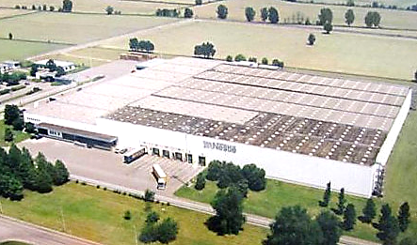
SAFETY DEVELOPMENT PLAN
ALBAIRATE
November 28, 2016

Slide 2
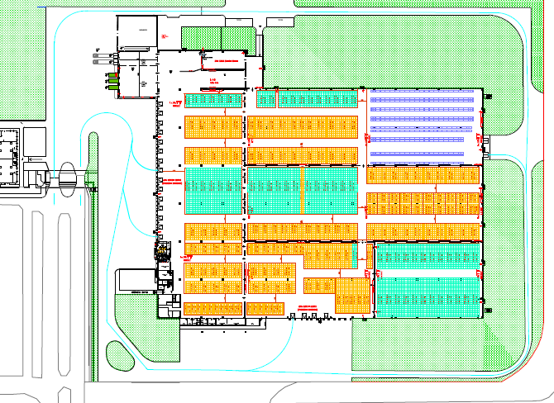

Pedestrians – external areas
1. Truck drivers must park their truck along the fence outside of the site

Slide 3
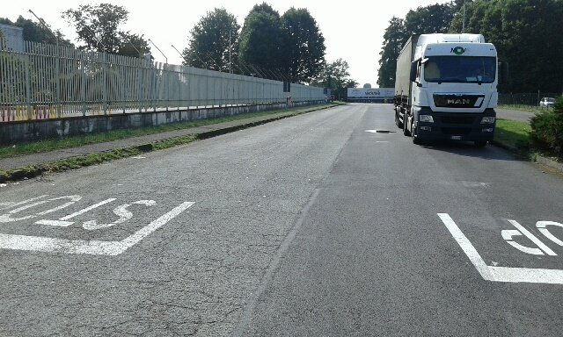
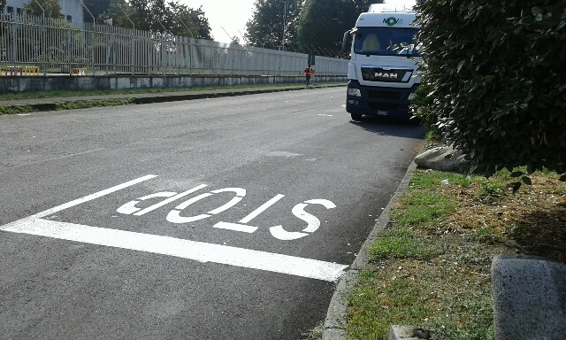
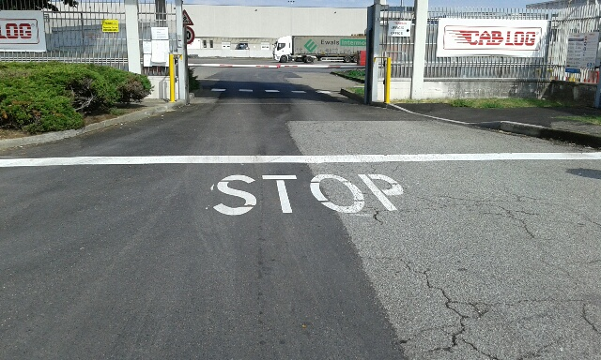
Pedestrians – external areas

Slide 4
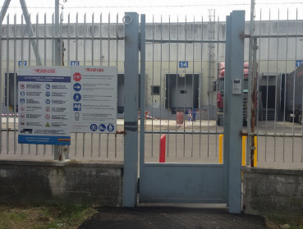

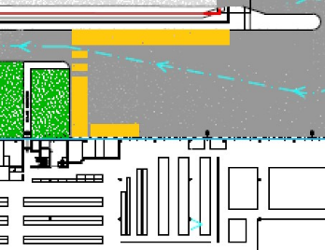

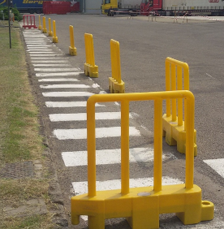
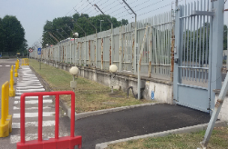
Pedestrians – external areas
2. Truck drivers must access the site from the pedestrian gate to reach the CABLOG office along the pedestrian walkway defined

Slide 5
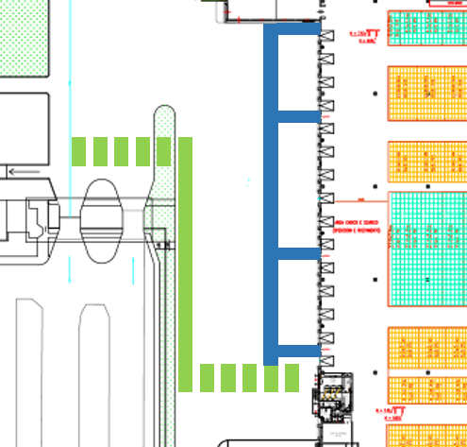
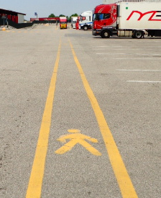
Pedestrians – external areas
3. No pedestrians can move outside of the walkways defined

Slide 6
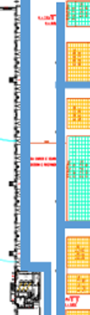
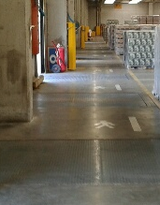
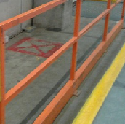
Truck drivers safety
In order to protect truck drivers from accidents during loading or unloading activities, truck drivers area near loading positions is protected with metal barrier (see photos below). Truck drivers must stay on the yellow area near loading position

Slide 7

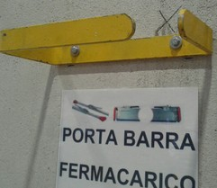
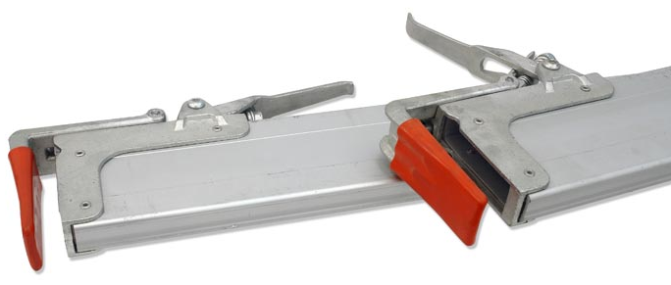
Truck drivers safety
To protect the drivers from any accidental fall of load securing beams, locking systems are placed in close proximity to each loading position. The driver will have to position the bars within the block

Slide 8
Truck drivers safety
We would like to introduce a new procedure to prevent any sudden departure of a truck during loading or unloading activities:
The driver positions the truck at the loading bay
The driver positions the locking wedge in order to avoid movements of the truck
The driver must enter in the warehouse via the walkways
When the driver arrives to his position, he must deliver the truck key to the operator
The operator must put the key of the truck in the security box
Only when the key is in the security box, the operator can start loading or unloading

Slide 9

Questions?
Thanks for your collaboration

